Slide 2
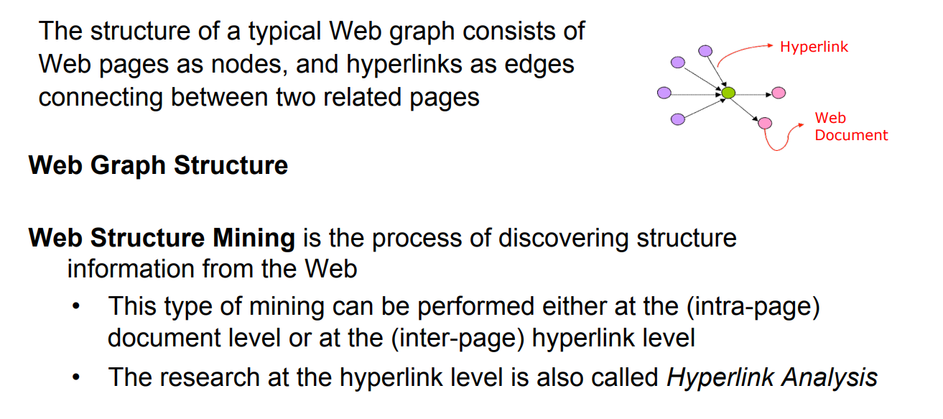
Web Structure Mining

Slide 3
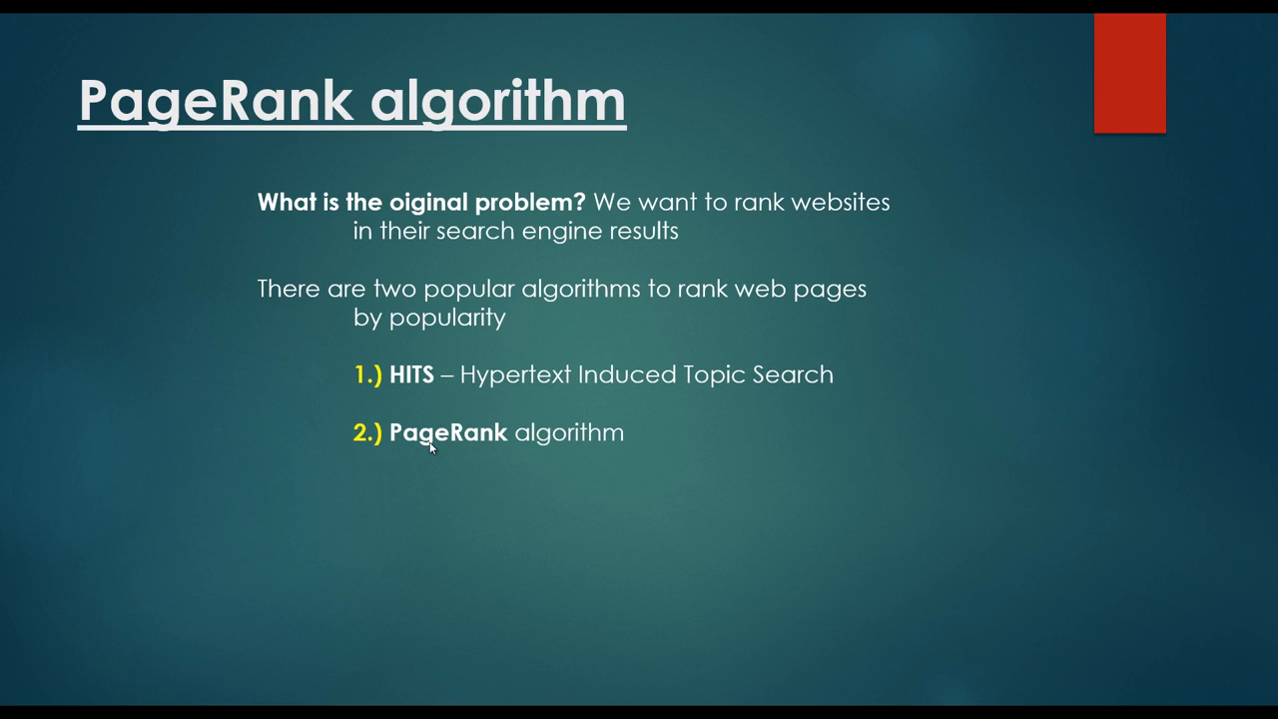

Slide 4
Page Rank Algorithm
Page Rank Algorithm

Slide 5
HITS Algorithm
Hyperlink Induced Topic Search (HITS) is an algorithm used in link analysis.
It could discover and rank the webpages relevant for a particular search.
The idea of this algorithm originated from the fact that an ideal website should link to other relevant sites and also being linked by other important sites.

Slide 6
HITS Algorithm
Hyperlink Induced Topic Search (HITS) Algorithm is a Link Analysis Algorithm that rates webpages, developed by Jon Kleinberg.
This algorithm is used to the web link-structures to discover and rank the webpages relevant for a particular search.
HITS uses hubs and authorities to define a recursive relationship between webpages. Before understanding the HITS Algorithm, we first need to know about Hubs and Authorities.

Slide 7
HITS uses hubs and authorities to define a recursive relationship between webpages.
Authority: A node is high-quality if many high-quality nodes link to it
Hub: A node is high-quality if it links to many high-quality nodes
Given a query to a Search Engine, the set of highly relevant web pages are called Roots. They are potential Authorities.
Pages that are not very relevant but point to pages in the Root are called Hubs. Thus, an Authority is a page that many hubs link to whereas a Hub is a page that links to many authorities.

Slide 8
HITS ALGORITHM
Algorithm Steps
Initialize the hub and authority of each node with a value of 1
For each iteration, update the hub and authority of every node in the graph
The new authority is the sum of the hub of its parents
The new hub is the sum of the authority of its children
Normalize the new authority and hub

Slide 9
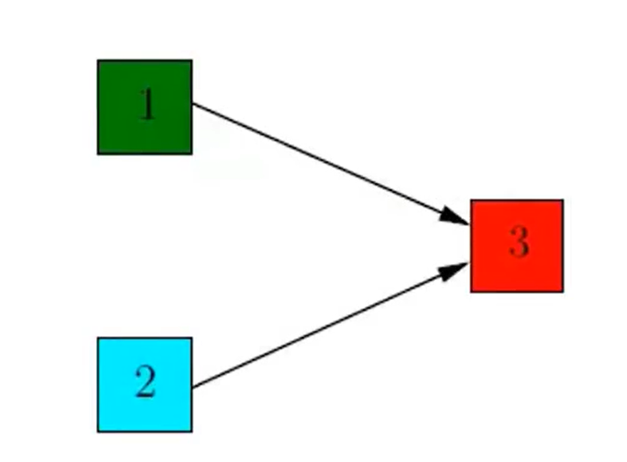
HITS Algorithm
Compute the Hub and Authority weights for the following graph.

Slide 10
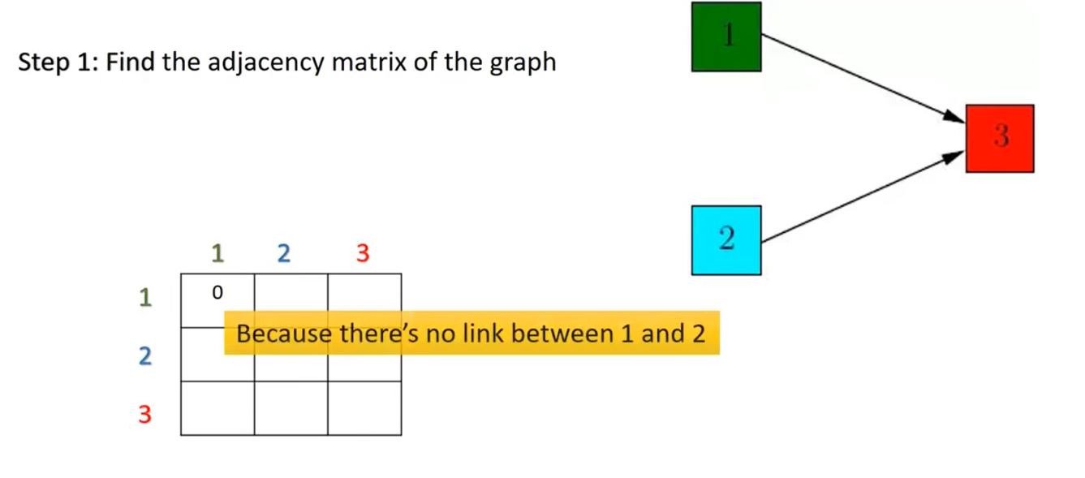
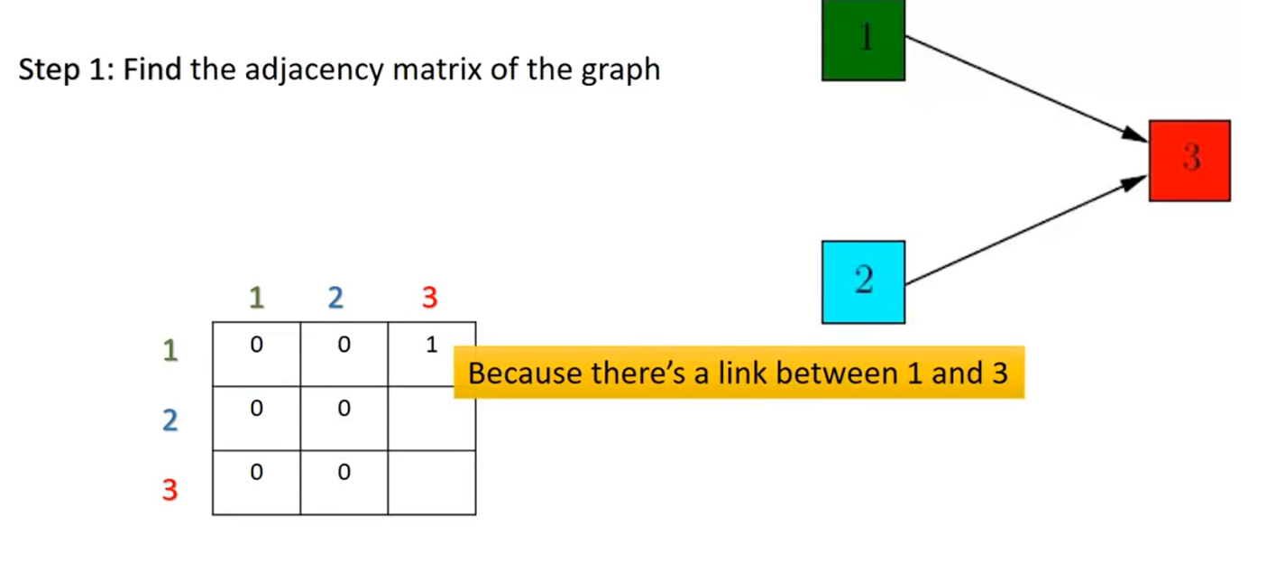
HITS Algorithm

Slide 11
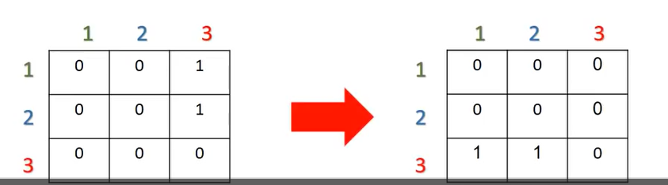
HITS Algorithm
Find transpose of the matrix

Slide 12
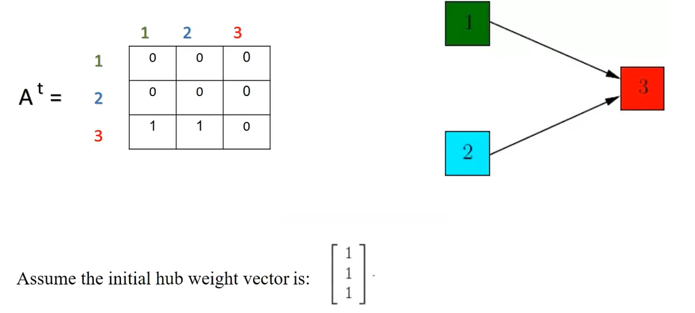
HITS Algorithm

Slide 13
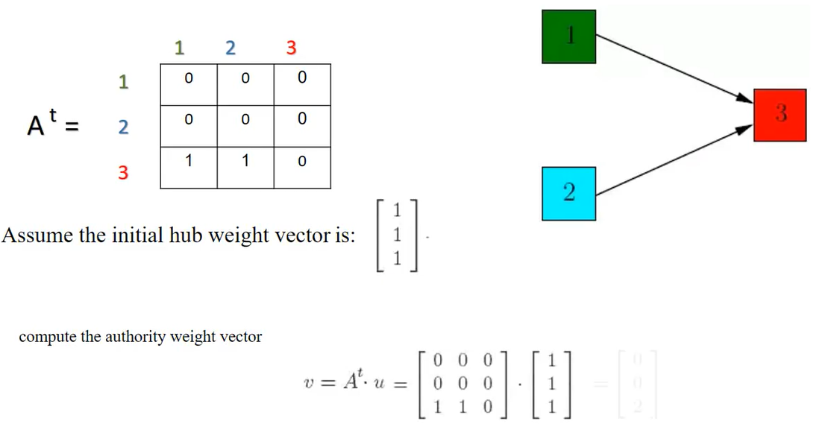
HITS Algoirthm

Slide 14
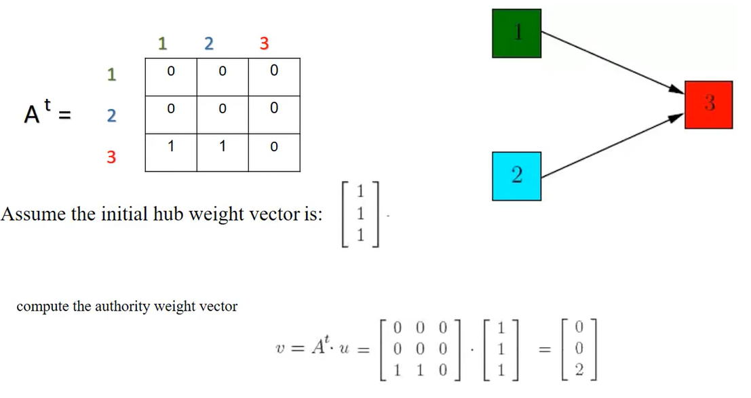
HITS Algorithm

Slide 15
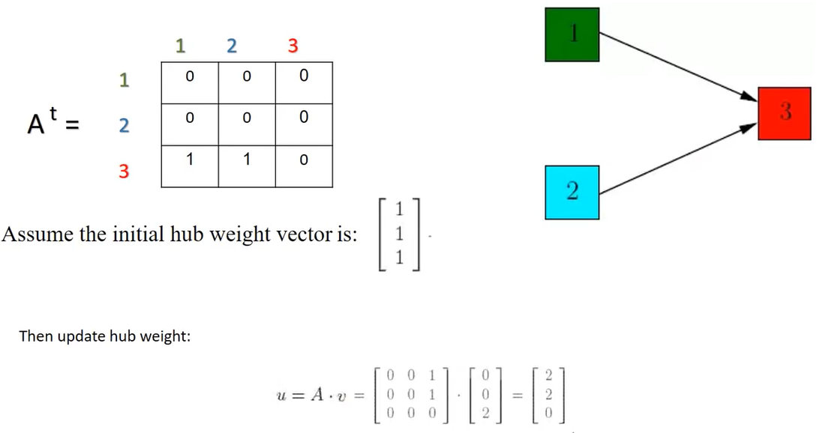
HITS Algorithm

Slide 16
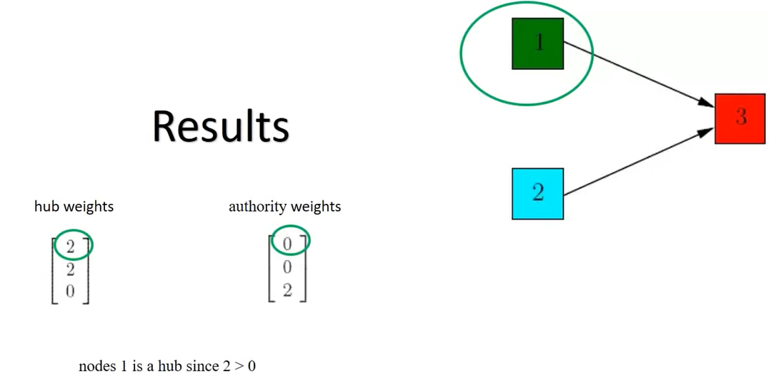
HITS Algorithm

Slide 17
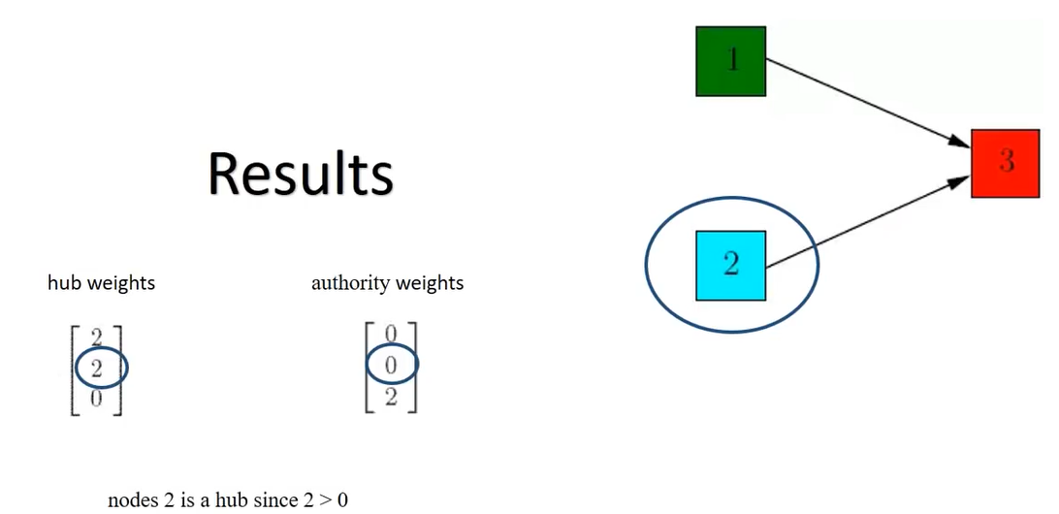
HITS Algorithm

Slide 18
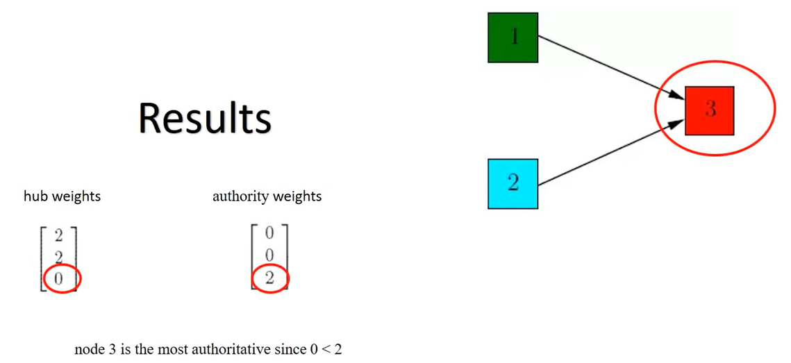
HITS Algorithm

Slide 19
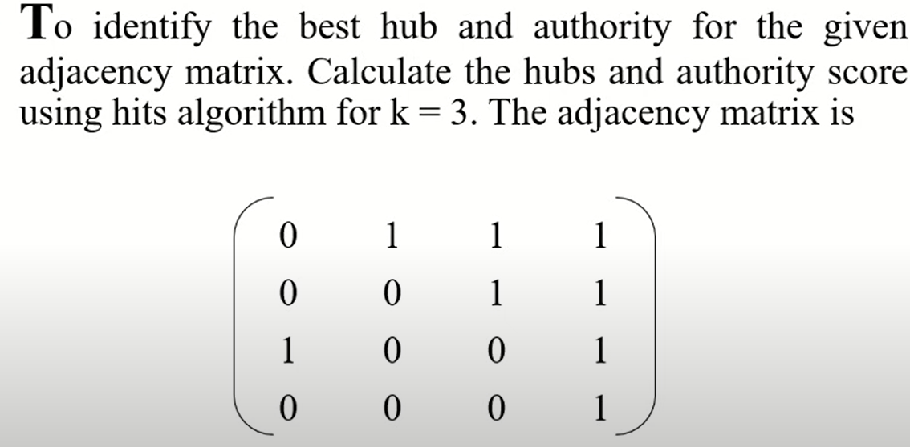
Example to solve

Slide 20
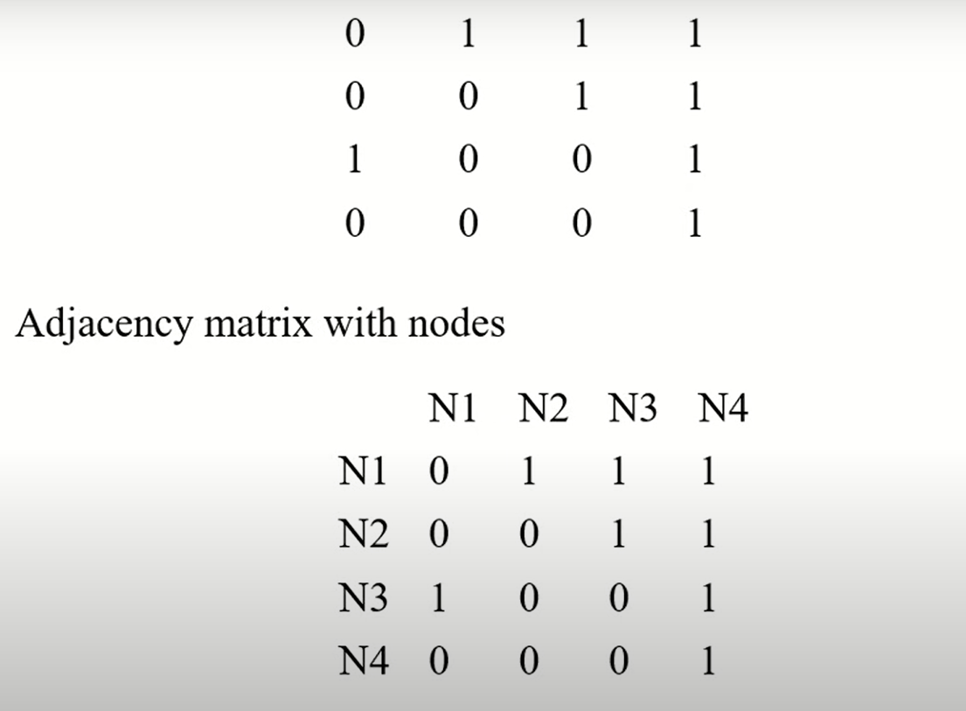
Example to solve

Slide 21
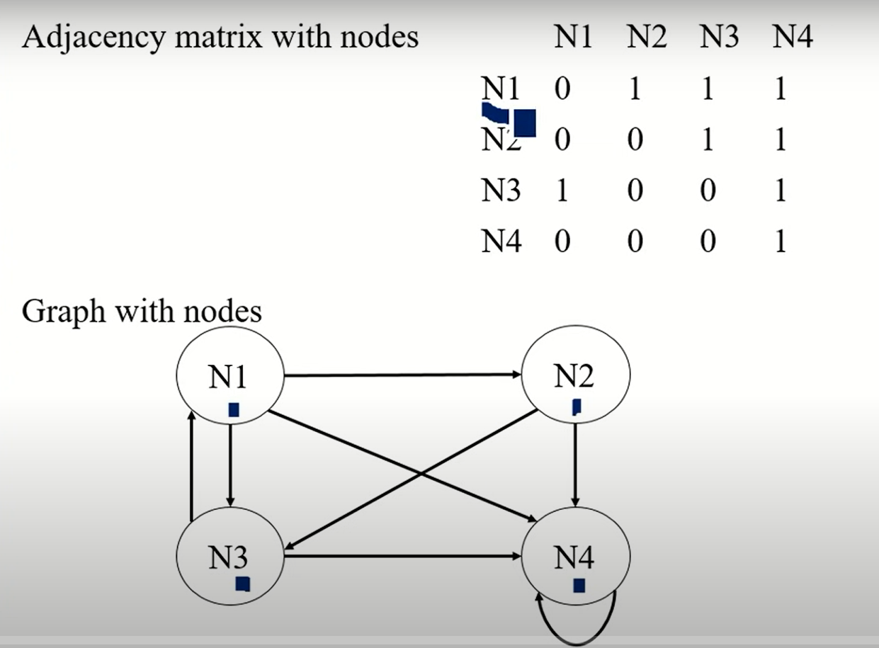
Example to solve

Slide 22
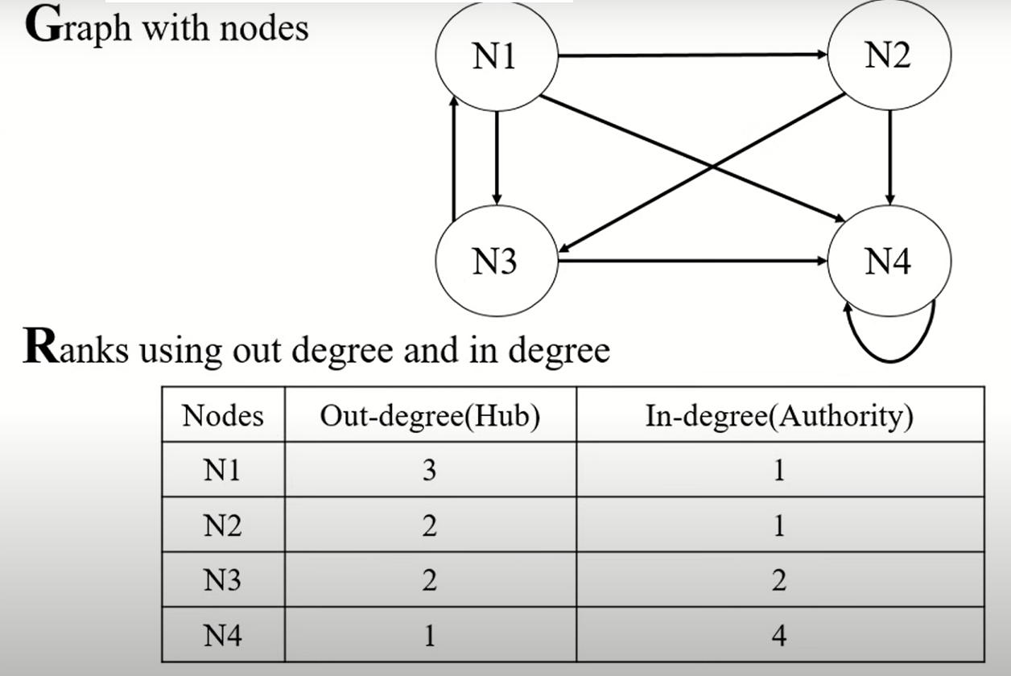
Example to solve

Slide 23
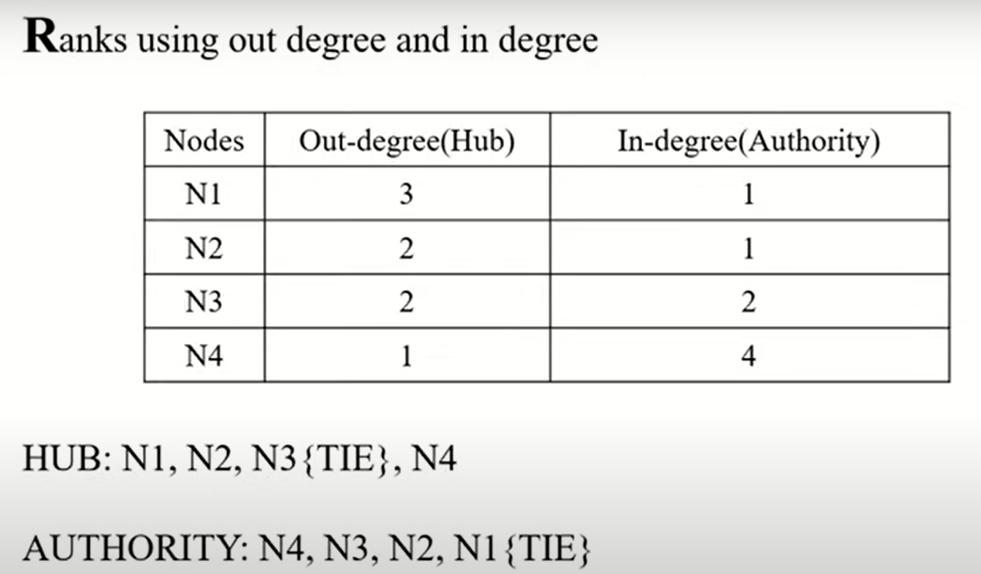
Example to solve

Slide 24
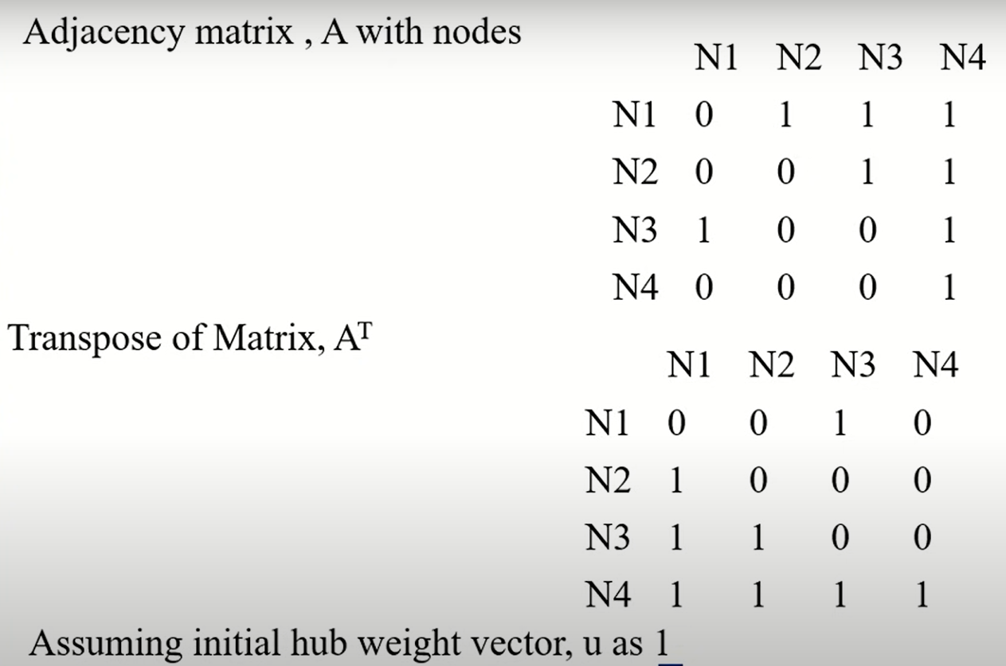
Example to solve

Slide 25
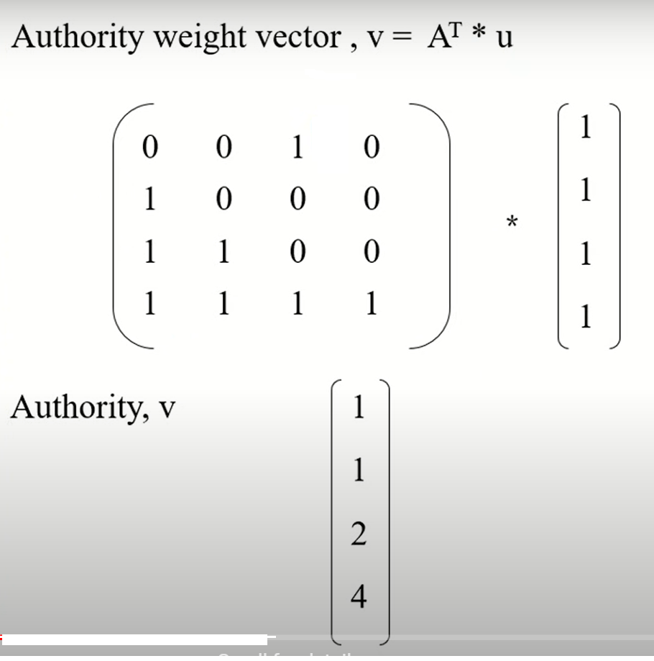
Example to solve

Slide 26
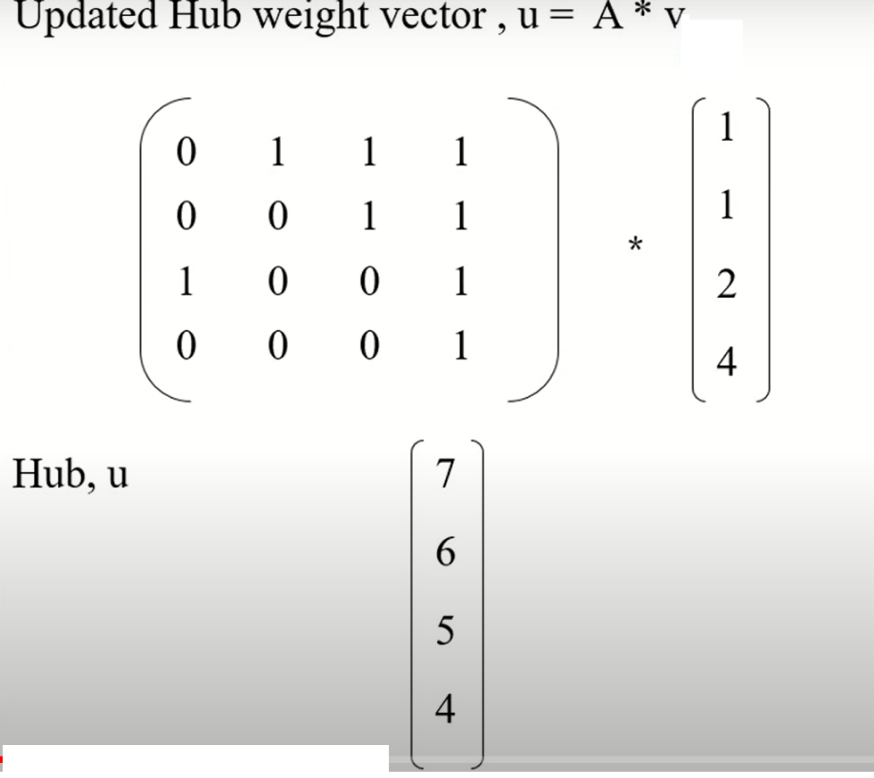
Example to solve

Slide 27
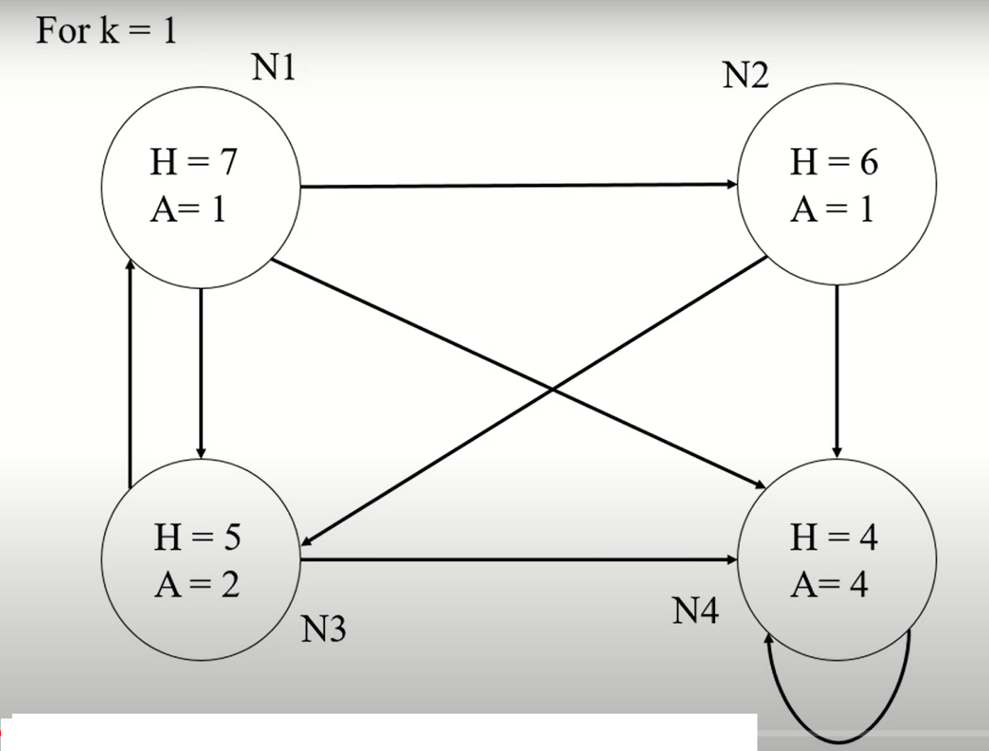
Example to solve

Slide 28
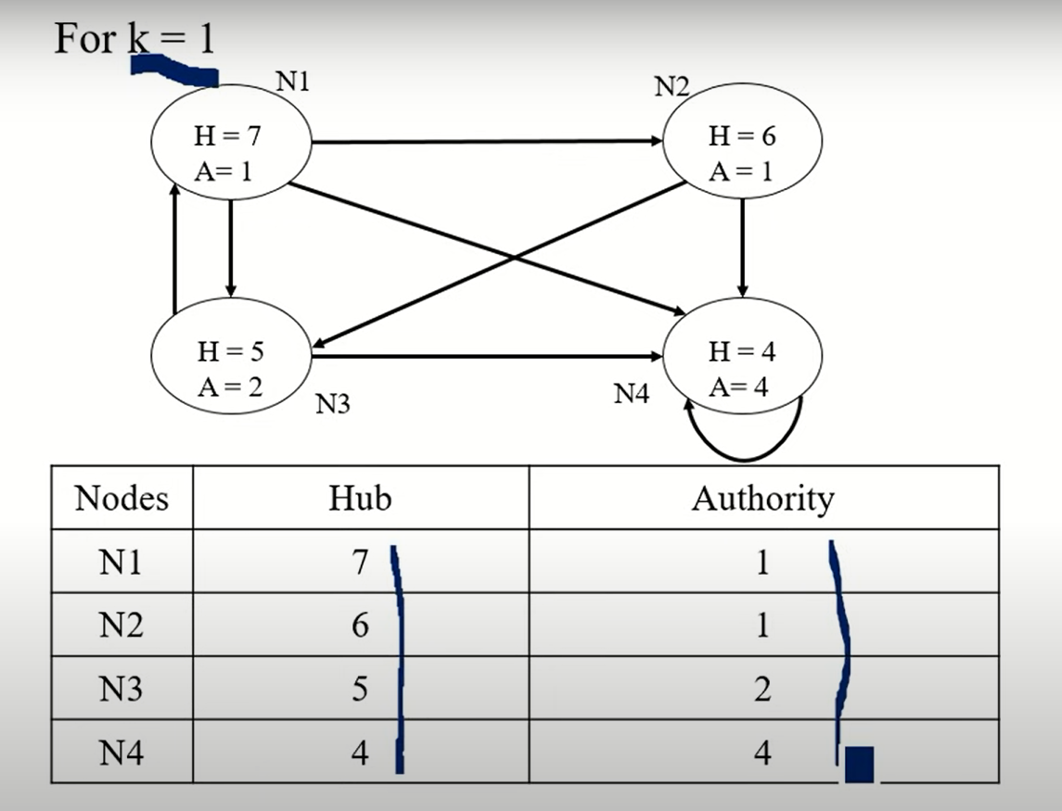
Example to solve

Slide 29
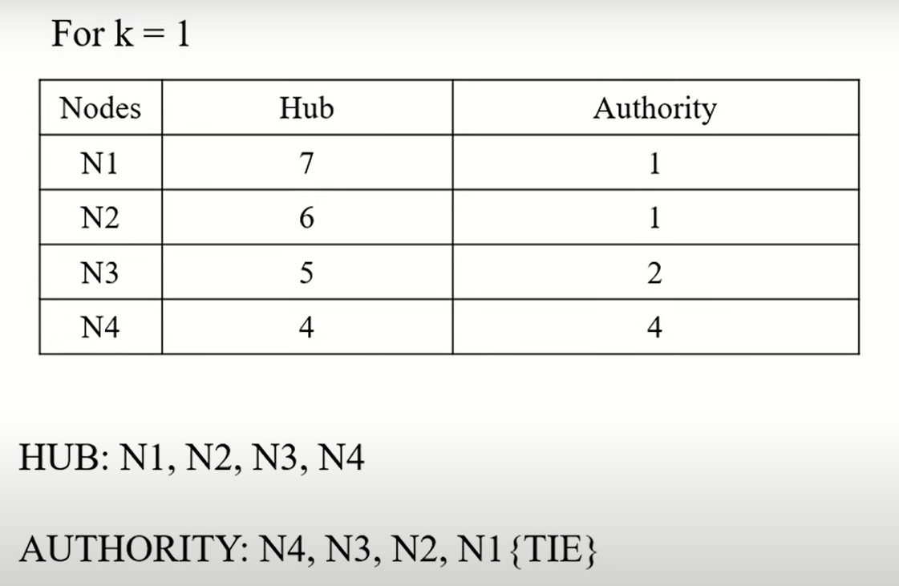
Example to solve

Slide 30
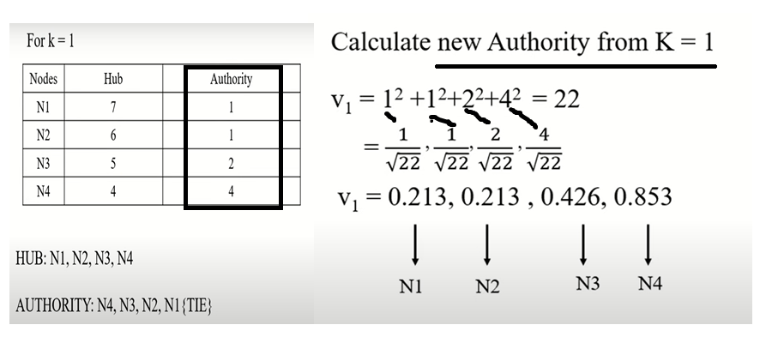
Example to Solve

Slide 31
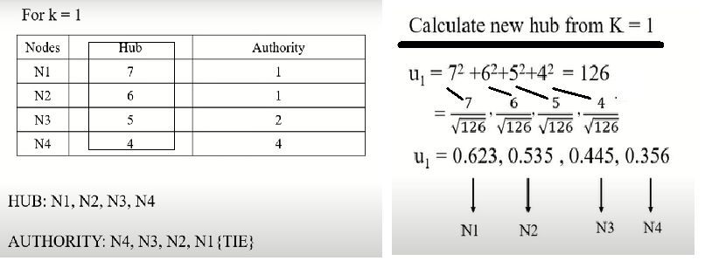
Example to Solve

Slide 32
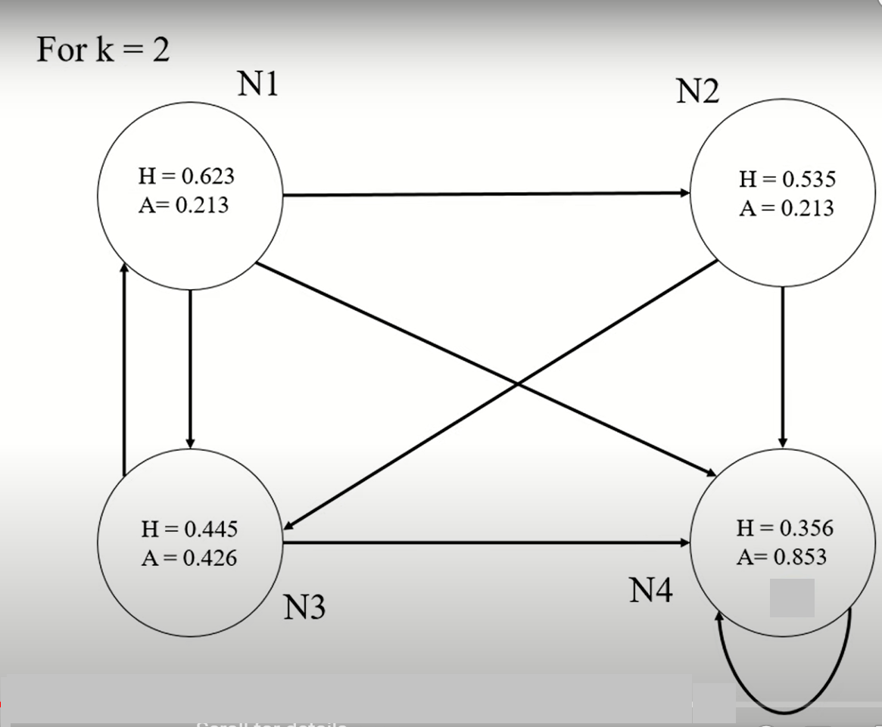
Example to Solve

Slide 33
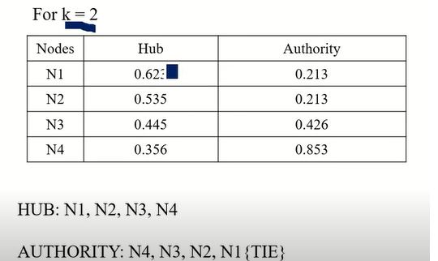
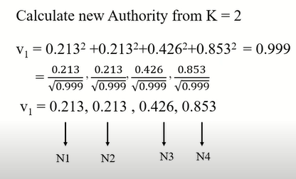
Example to Solve

Slide 34
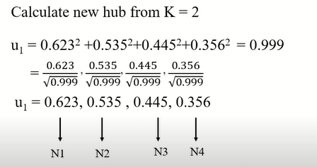
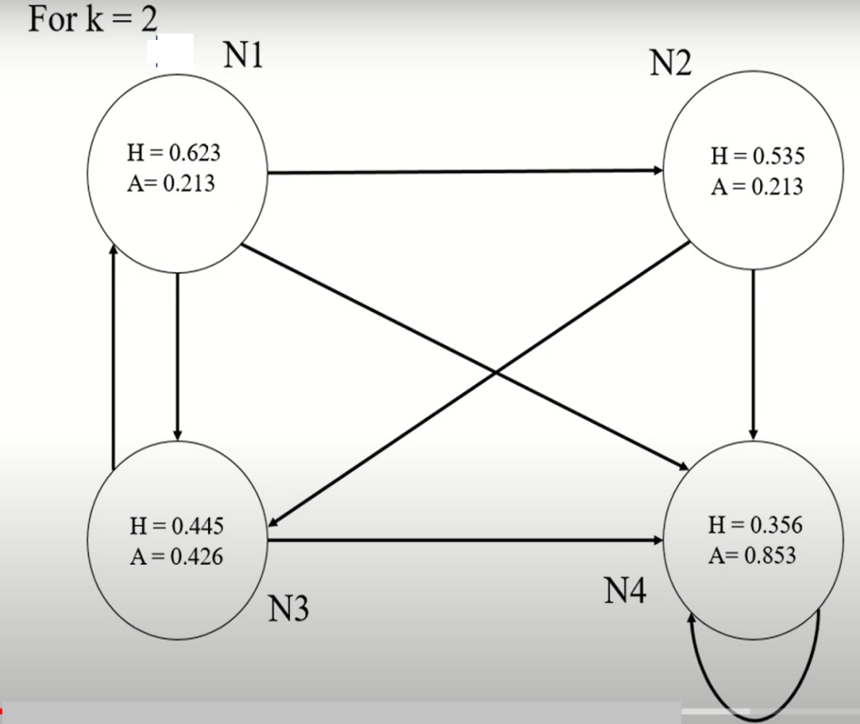
Example to Solve

Slide 35
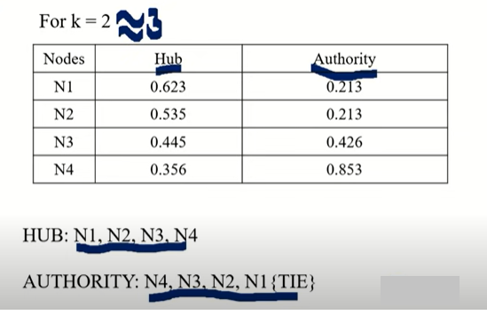
Example to Solve
WHERE Hub and authority scores have come to a consistent value FOR K2 AND K3 , ALGORITHM WILL STOP.

Slide 36
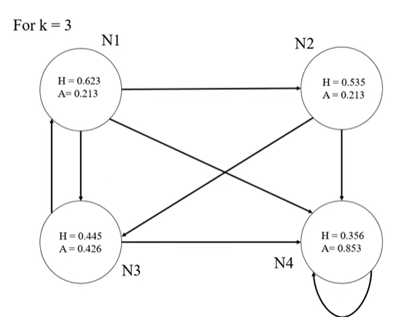
Example to Solve

